Slide 1
Project Management Concepts
Keerthy A s

Slide 2
The Four P’s
People — the most important element of a successful project
Product — the software to be built
Process — the set of framework activities and software engineering tasks to get the job done
Project — all work required to make the product a reality

Slide 3
People
Stakeholders
Senior managers - define the business issues
Project (technical) managers- plan, motivate, organize, and control the practitioners
Practitioners - technical to engineer a product or application.
Customers - requirements
End-users - interact with the software

Slide 4
Team Leader
The MOI Model
Motivation.
Organization.
Ideas or innovation.
Problem-solving.
Managerial identity.
Appreciate Achievement
Influence and team building

Slide 5
Software Teams
The difficulty of the problem to be solved
The size of the resultant program(s) in lines of code or function points
The time that the team will stay together (team lifetime) and the degree to which the problem can be modularized
The required quality and reliability of the system to be built within the rigidity of the delivery date
The degree of sociability (communication) required for the project

Slide 6
Organizational Paradigms
Closed paradigm—structures a team along a traditional hierarchy of authority
random paradigm—structures a team loosely and depends on the individual initiative of the team members
open paradigm—attempts to structure a team in a manner that achieves some of the controls associated with the closed paradigm but also much of the innovation that occurs when using the random paradigm
synchronous paradigm—relies on the natural compartmentalization of a problem and organizes team members to work on pieces of the problem with little active communication among themselves

Slide 7
Avoid Team “Toxicity”
A frenzied work atmosphere in which team members waste energy and lose focus on the objectives of the work to be performed.
High frustration caused by personal, business, or technological factors that cause friction among team members.
Fragmented or poorly coordinated procedures” or a poorly defined or improperly chosen process model that becomes a roadblock to accomplishment.
Unclear definition of roles resulting in a lack of accountability and resultant finger-pointing.
Continuous and repeated exposure to failure leads to a loss of confidence and a lowering of morale.

Slide 8
Agile Teams
Team members must have trust in one another.
The distribution of skills must be appropriate to the problem.
Mavericks may have to be excluded from the team, if team cohesiveness is to be maintained.
Team is “self-organizing”
An adaptive team structure
Uses elements of Constantine’s random, open, and synchronous paradigms
Significant autonomy

Slide 9
Team Coordination & Communication
Formal, impersonal -source code, technical memos, project milestones, schedules, project control tools, change requests and related documentation, error tracking reports, and repository data.
Formal, interpersonal -status review meetings and design and code inspections.
Informal, interpersonal - group meetings for information dissemination and problem-solving
Electronic communication - electronic mail, electronic bulletin boards, and video conferencing.
Interpersonal networking - informal discussions - team members, outside the project with experience or insight that can assist team members.

Slide 10
The Product Scope
SCOPE
Context
How does the software to be built fit into a larger system, product, or business context, and what constraints are imposed as a result of the context?
Information objectives.
What customer-visible data objects are produced as output from the software?
What data objects are required for input?
Function and performance.
What function does the software perform to transform input data into output?
Are any special performance characteristics to be addressed?
Software project scope must be unambiguous and understandable at the management and technical levels.

Slide 11
Problem Decomposition
Sometimes called partitioning or problem elaboration
Once scope is defined
It is decomposed into constituent functions
It is decomposed into user-visible data objects
It is decomposed into a set of problem classes
Decomposition process continues until all functions or problem classes have been defined

Slide 12
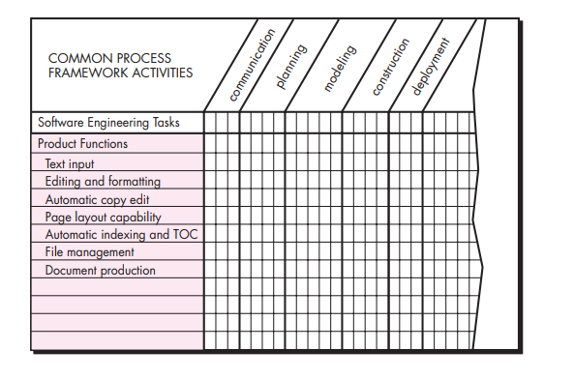
The Process
Melding the Product and the Process

Slide 13
The Process decomposition
Once a process framework has been established
Consider project characteristics
Determine the degree of rigor required
Define a task set for each software engineering activity
Task set =
Software engineering tasks
Work products
Quality assurance points
Milestones

Slide 14
The Project
Projects get into trouble when …
Software people don’t understand their customer’s needs.
The product scope is poorly defined.
Changes are managed poorly.
The chosen technology changes.
Business needs change [or are ill-defined].
Deadlines are unrealistic.
Users are resistant.
Sponsorship is lost [or was never properly obtained].
The project team lacks people with appropriate skills.
Managers [and practitioners] avoid best practices and lessons learned.

Slide 15
Common-Sense Approach to Projects
Work hard to understand the problem and set realistic objectives and expectations.
Maintain momentum- the team should emphasize quality in every task, and senior management should do everything possible to stay out of the team’s way.
Track progress. - progress is tracked as work products (e.g., models, source code, sets of test cases) and approved (using formal technical reviews) as part of a quality assurance activity.
Make smart decisions - “keep it simple.”
Conduct a postmortem analysis - Extract lessons learned for each project.

Slide 16
To Get to the Essence of a Project: W⁵HH principle
Why is the system being developed?
What will be done?
When will it be accomplished?
Who is responsible?
Where are they organizationally located?
How will the job be done technically and managerially?
How much of each resource (e.g., people, software, tools, database) will be needed?

Slide 17
Critical Practices
Formal risk management
Empirical cost and schedule estimation
Metrics-based project management
Earned value (of tasks) tracking
Defect tracking against quality targets
People aware project management

